Slide 1
Datatype and Data Structure
Notes:
http://adv-r.had.co.nz/Data-structures.html
https://www.tutorialspoint.com/r/r_data_types.htm

Slide 2
Workshop Objective
Expose learners to the different data types in R and show how these data types are used in data structures.
Learn how to create vectors of different types.
Be able to check the type of vector.
Learn about missing data and other special values.
Get familiar with the different data structures (lists, matrices, data frames).
Notes:
https://monashbioinformaticsplatform.github.io/2015-09-28-rbioinformatics-intro-r/01-supp-data-structures.html

Slide 3
DateType?
Numeric (/integer)
Character (Strings)
Logical (Boolean)
Factor (Levels)
Notes:
https://intro2r.com/data-types.html

Slide 4
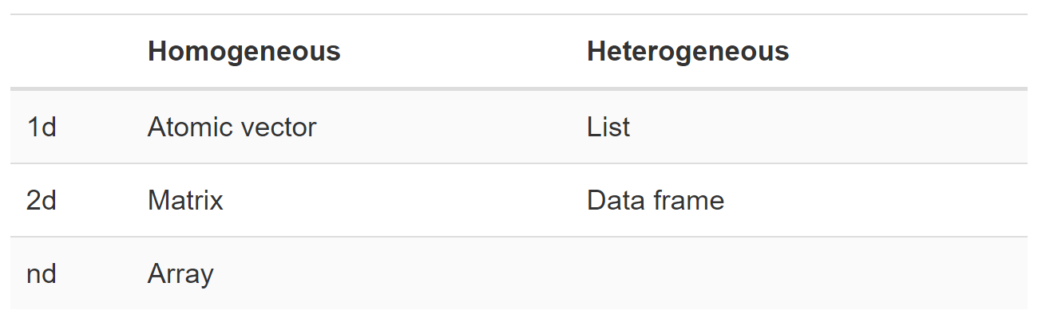
Data Structure

Slide 5
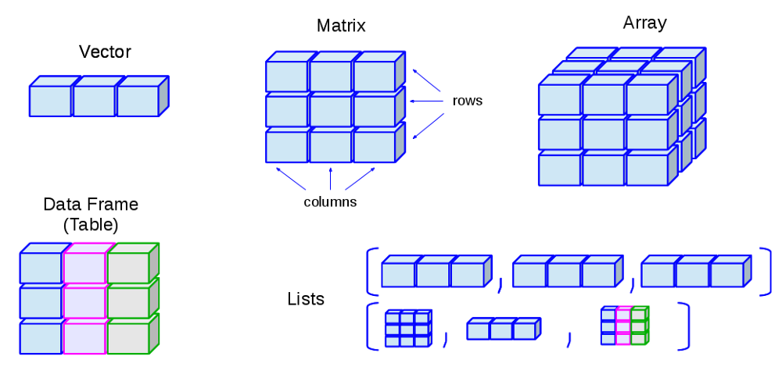
Notes:
https://www.datasciencecentral.com/profiles/blogs/understand-basic-to-advance-data-structure-used-in-r-to-use-it

Slide 6
num <- 2.2
class(num)
## [1] "numeric"
char <- "hello"
class(char)
## [1] "character"
logi <- TRUE
class(logi)
## [1] "logical"
factor <- c(high, low medium)
class(factor[1])
##[1] ”factor”

Slide 7
Relational Database Structure (SQL)
In short, SQL databases support SQL—a domain-specific language for querying and manipulating data in a relational database.
The "relational" in a relational database refers to the "relational model" of data management devised by IBM researcher E.F. Codd in the early 1970s and popularized in a number of subsequent database systems starting with System R.
Notes:
https://www.ibm.com/cloud/blog/sql-vs-nosql

Slide 8
Non Relational Database Structure (noSQL)
As a response to the "throwing the baby out with the bathwater" problems with NoSQL (see below) in the early 2010s, several organizations began building relational/SQL-based systems that made different tradeoffs, particularly with regard to horizontal scalability.
More popular in web development and OOP
Notes:
https://www.ibm.com/cloud/blog/sql-vs-nosql
Scalability: https://www.scalyr.com/blog/horizontal-scalability-software/
al scalability:

Slide 9
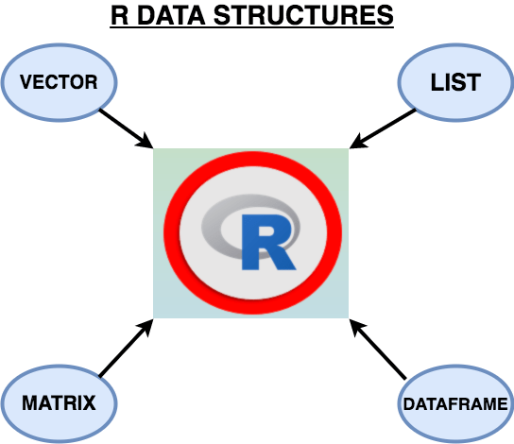
Data Structure
Notes:
https://www.datacamp.com/community/tutorials/data-types-in-r

Slide 10
Vectors
A vector is just a set of objects of the same type. You can create logical, character, numeric, complex or even factor vectors, among others.
Vector <- c(1,2,3,7)
Vector <- c(“Hello”,”How are you”,”good morning”)

Slide 11
Matrices
In R, a matrix is a collection of elements of the same data type (numeric, character, or logical) arranged into a fixed number of rows and columns.
Since you are only working with rows and columns, a matrix is called two-dimensional.
Matrix <- as.matrix(rnorm(1000), nrow=10)

Slide 12
Lists
Lists are the R objects which contain elements of different types like − numbers, strings, vectors and another list inside it. A list can also contain a matrix or a function as its elements. List is created using list() function.
list_data <- list("Red", "White", c(1,2,3), TRUE, 22.4)
List object can also consain other list, which itself contain another list
Notes:
https://www.tutorialspoint.com/r/r_lists.htm

Slide 13
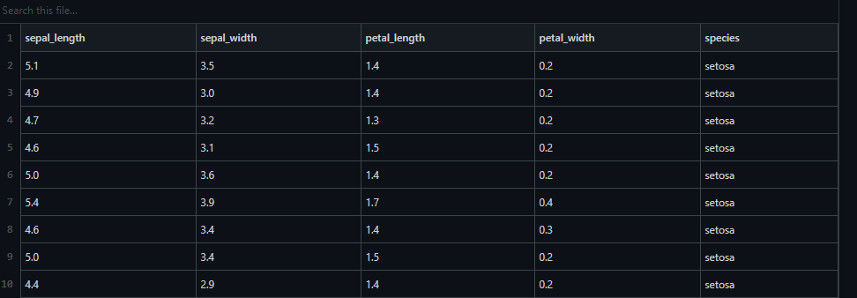
DataFrames
Data frame is the de-facto data type for most data science projects, as it's organized in tabular format.
A data frame has the variables of a data set as columns and the observations as rows.
Iris <- as.data.frame(iris)
Notes:
https://www.pluralsight.com/guides/querying-and-converting-data-types-in-r
https://campus.datacamp.com/courses/free-introduction-to-r/chapter-5-data-frames?ex=1
A data frame is a list of equal-length vectors. This makes it a 2-dimensional structure, so it shares properties of both the matrix and the list.

Slide 14
Tibbles
A tibble is a special type of data frame with some additional properties.
Tibbles work with column names that are not syntactically valid variable names.
Tibbles prevent partial matching of arguments
Tibbles prevent dimension dropping
Some call it a better and improved dataframe, but can be confusing to use at first
Notes:
https://r4ds.github.io/bookclub-tmwr/tibbles-vs-data-frames.html
https://cran.r-project.org/web/packages/tibble/vignettes/tibble.html

Slide 15
So let’s us stick with data-frame for now

Slide 16
How would you know the class?
Use the class() command, or the typeof()
> typeof(flights)
[1] "list"
> class(flights)
[1] "data.frame"
Notes:
https://www.tutorialspoint.com/what-is-the-difference-between-class-and-typeof-function-in-r

Slide 17
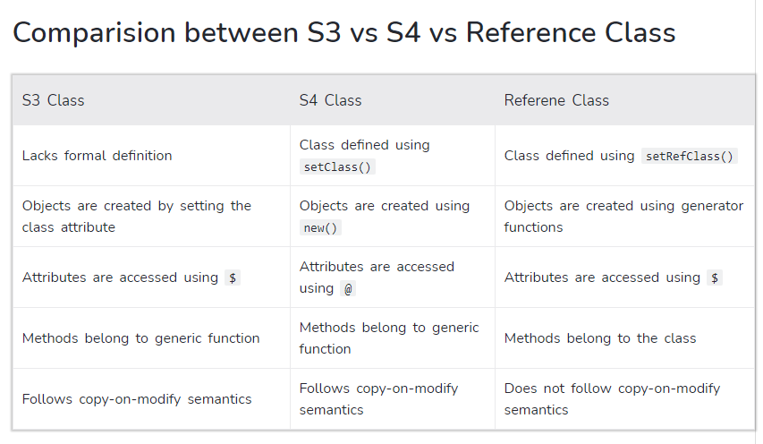
S3, S4 Object in R (Object Oriented Programming)
Notes:
http://adv-r.had.co.nz/S4.html
https://docs.google.com/presentation/d/1LJ_wz-94waOovoHXq6RNNTIUAFeIN9hfvqzh3Xz9kRM/edit#slide=id.p

Slide 18
Quiz
What are the three properties of a vector, other than its contents?
What are the four common types of atomic vectors? What are the two rare types?
What are attributes? How do you get them and set them?
How is a list different from an atomic vector? How is a matrix different from a data frame?
Can you have a list that is a matrix? Can a data frame have a column that is a matrix?

Slide 19
Answers
The three properties of a vector are type, length, and attributes.
The four common types of atomic vector are logical, integer, double (sometimes called numeric), and character. The two rarer types are complex and raw.
Attributes allow you to associate arbitrary additional metadata to any object. You can get and set individual attributes with attr(x, "y") and attr(x, "y") <- value; or get and set all attributes at once with attributes().
The elements of a list can be any type (even a list); the elements of an atomic vector are all of the same type. Similarly, every element of a matrix must be the same type; in a data frame, the different columns can have different types.
You can make “list-array” by assigning dimensions to a list. You can make a matrix a column of a data frame with df$x <- matrix(), or using I() when creating a new data frame data.frame(x = I(matrix())).

Slide 20
Let’s head to R

